Slide 1





Unit
8
JUST GO FOR IT Lesson 3: And now some practical advice…

Slide 2
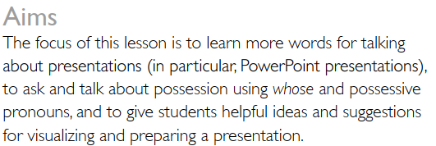
LESSON 3
AND NOW SOME PRACTICAL ADVICE…….

Slide 3
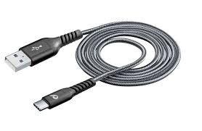
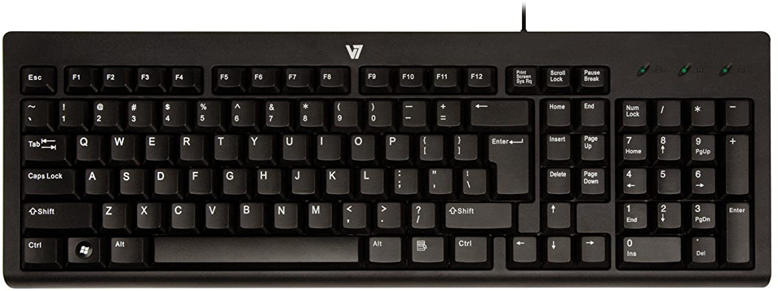

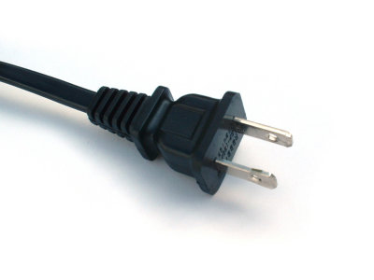
VOCABULARY
Presentation equipment
Match the picture with the word.
1
4
a)cable b)remote control
c)vase d)projector e)mouse
f)memory stick (flash drive)
g)microphone h)keyboard
i)laptop j)slide k)screen
l)plug
2
3

Slide 4
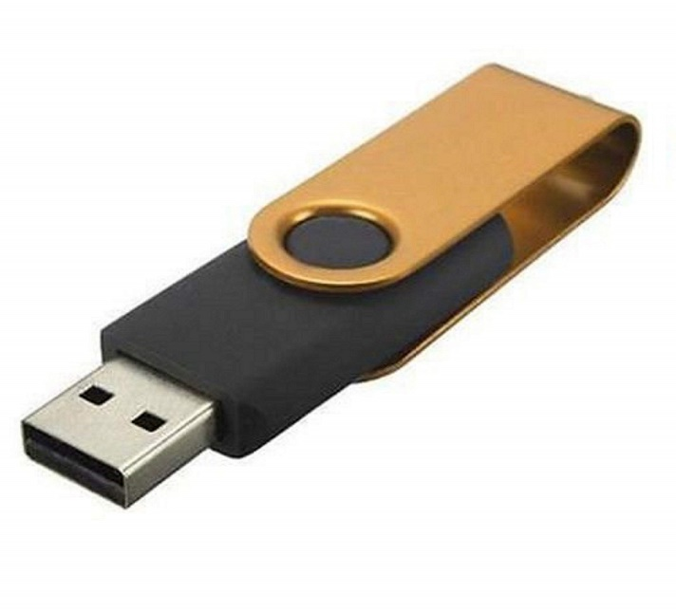

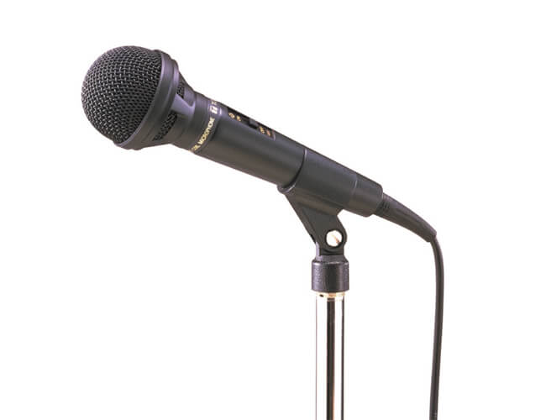

VOCABULARY
Presentation equipment
Match the picture with the word.
7
8
5
a)cable b)remote control
c)vase d)projector e)mouse
f)memory stick (flash drive)
g)microphone h)keyboard
i)laptop j)slide k)screen
l)plug
6

Slide 5
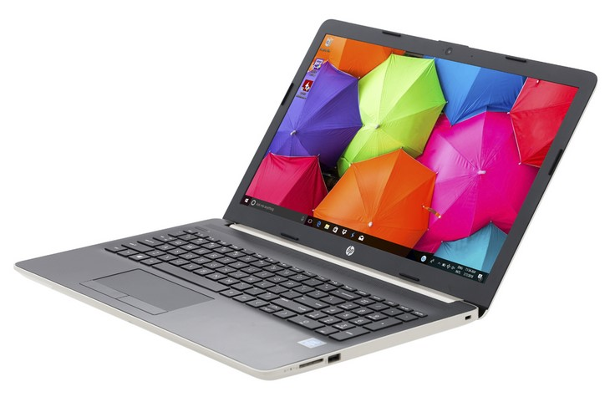
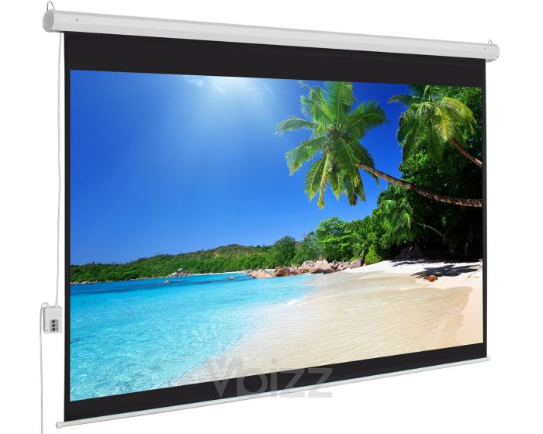
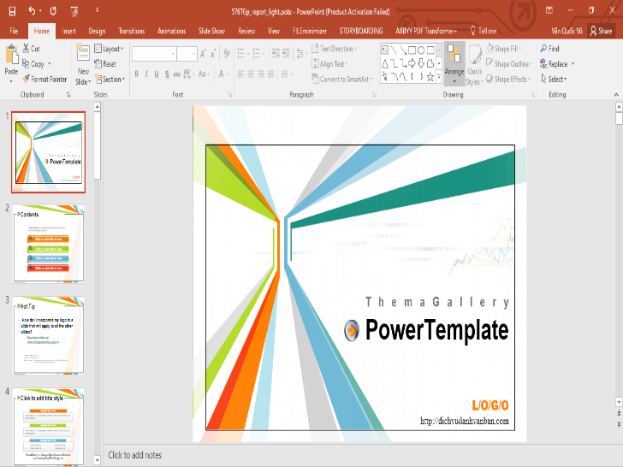
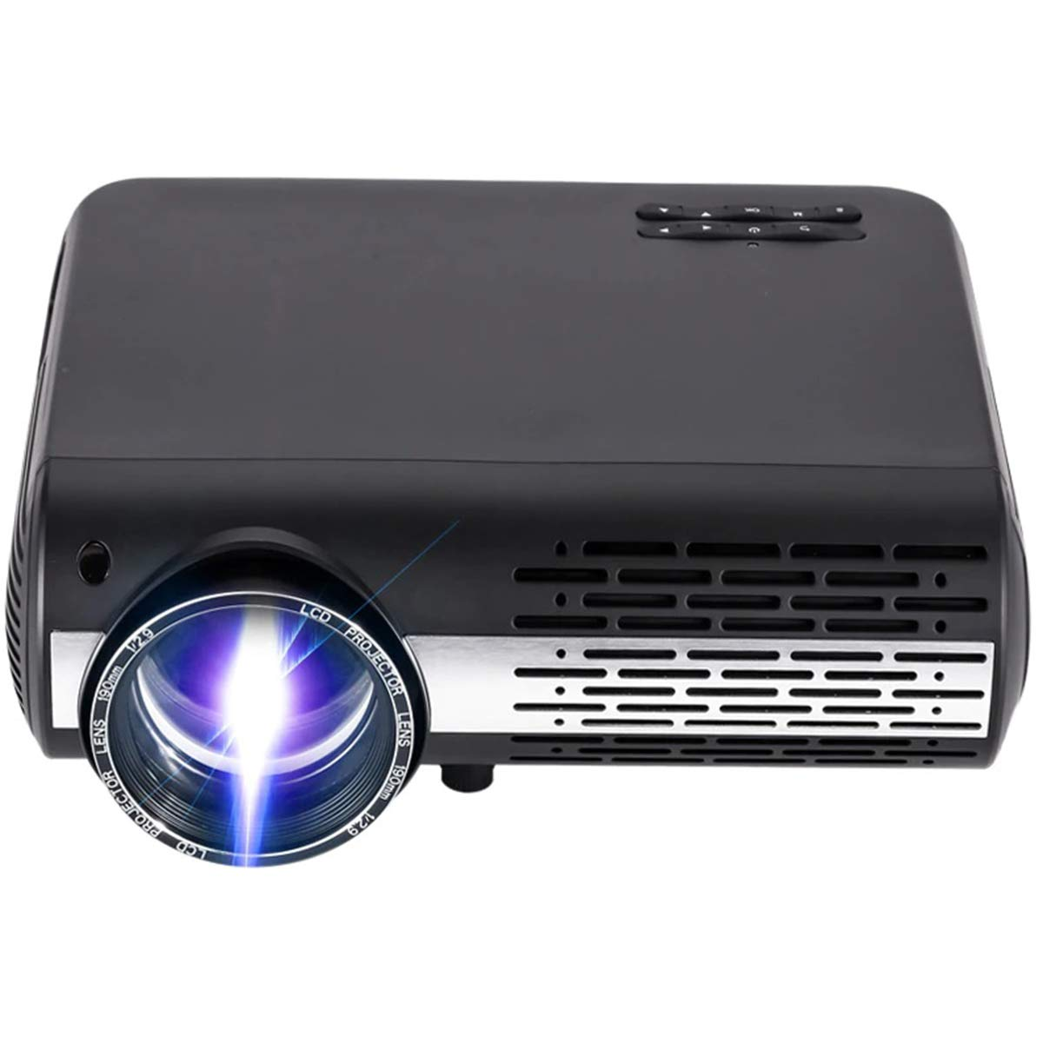
VOCABULARY
Presentation equipment
Match the picture with the word.
10
11
9
a)cable b)remote control
c)vase d)projector e)mouse
f)memory stick (flash drive)
g)microphone h)keyboard
i)laptop j)slide k)screen
l)plug
12

Slide 6

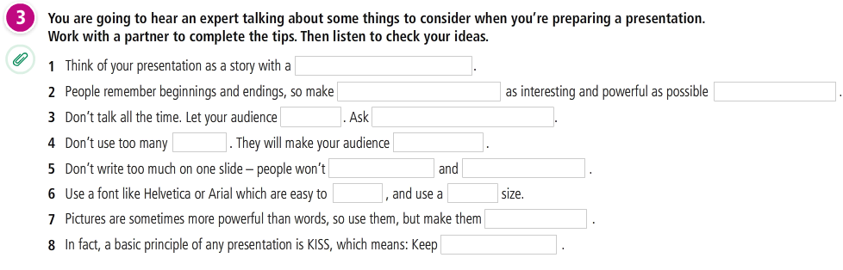
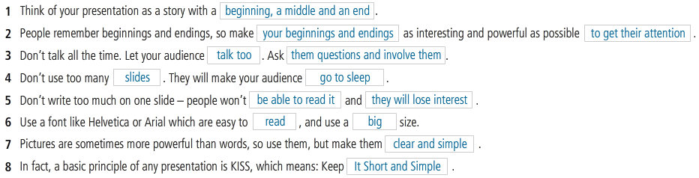
LISTENING

Slide 7
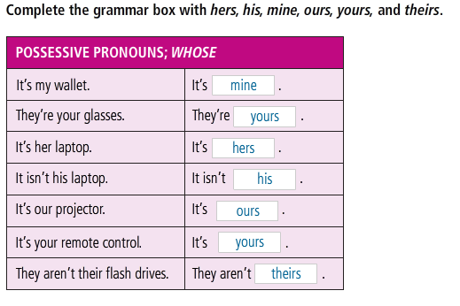
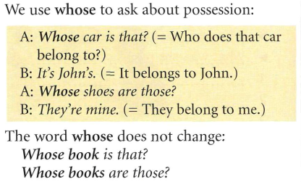
GRAMMAR
POSSESSIVE PRONOUNS: WHOSE

Slide 8
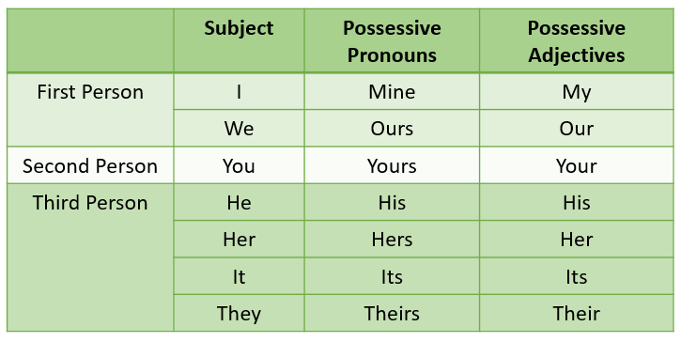
GRAMMAR
POSSESSIVE PRONOUNS: WHOSE
www.youtube.com/watch?v=v9jYTZNI_bA

Slide 9
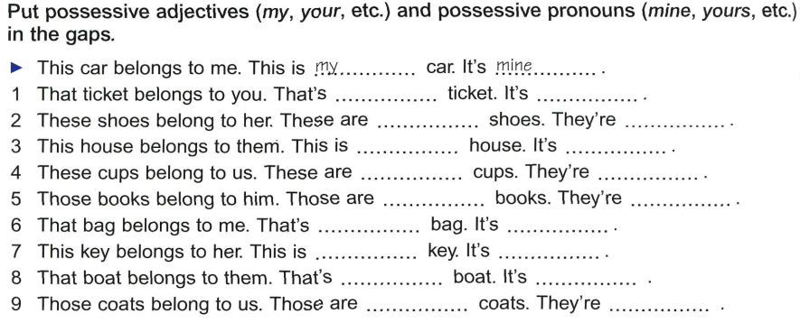
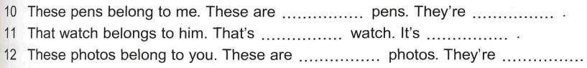
GRAMMAR
POSSESSIVE PRONOUNS: WHOSE

Slide 10
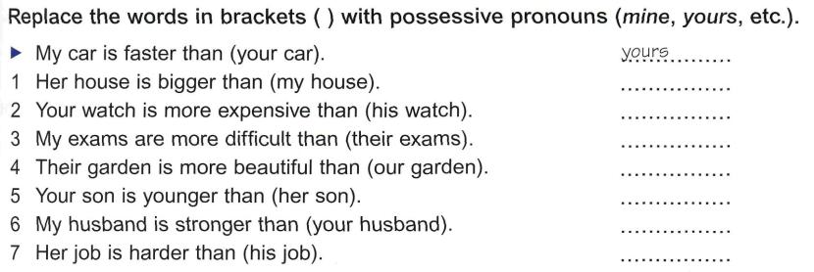
GRAMMAR
POSSESSIVE PRONOUNS: WHOSE

Slide 11
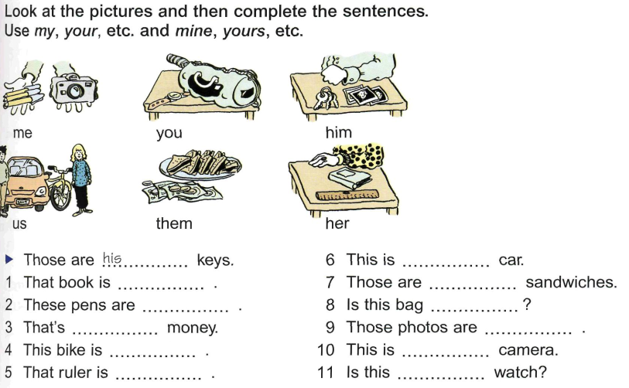
GRAMMAR
POSSESSIVE PRONOUNS: WHOSE

Slide 12
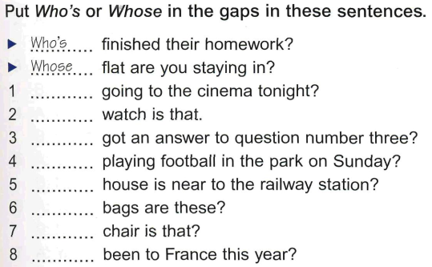
GRAMMAR
POSSESSIVE PRONOUNS: WHOSE

Slide 13
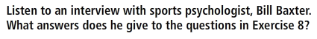
LISTENING 2
Many people use a technique called “visualization” to help them perform well.
1. What is “visualization”?
2. What kinds of things can you use it for?

Slide 14
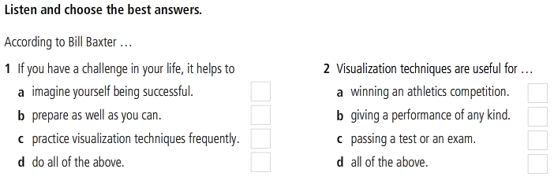
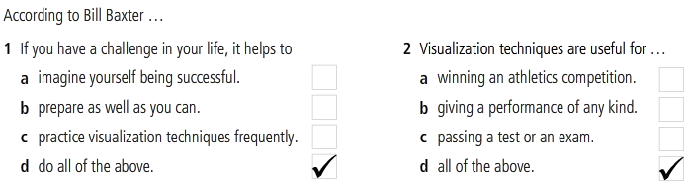
LISTENING 2

Slide 15
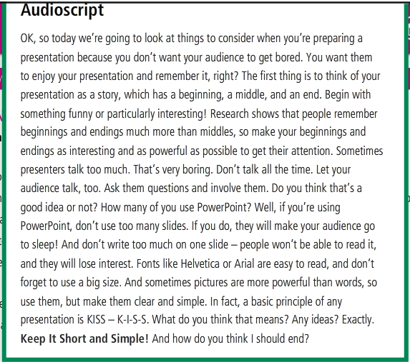
AUDIOSCRIPT

Slide 16
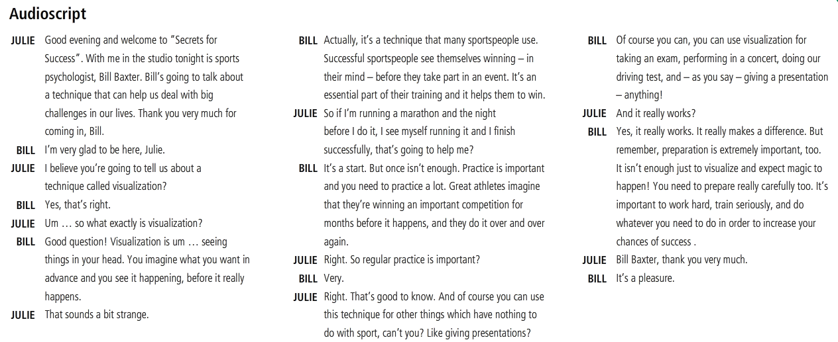
AUDIOSCRIPT

Slide 17
References
Grammar: Possessive Pronouns
https://www.youtube.com/watch?v=obgsPU76rLE
https://www.youtube.com/watch?v=ptU9lEiyuQQ
https://www.youtube.com/watch?v=v9jYTZNI_bA

